Slide 1
Modeling of Blood Flow in Zebrafish With Cancer
Soran Najat Ibrahim

Slide 2
Topics
Introduction
Modeling fluid dynamics
Coupled Darcy-Stokes equation
The finite element method
Numerical experiments
Discussion

Slide 3
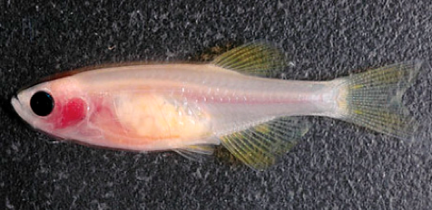
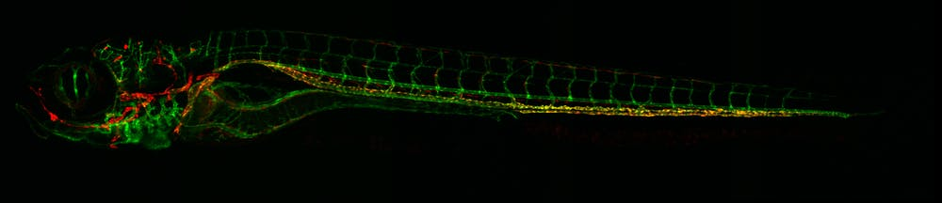
Introduction
Zebrafish in research
Benefits of the zebrafish
Small and robust
Grow at an extremely fast rate
Similar genetic structure to humans
Nearly transparent embryos
Similar genetic structure to humans

Slide 4
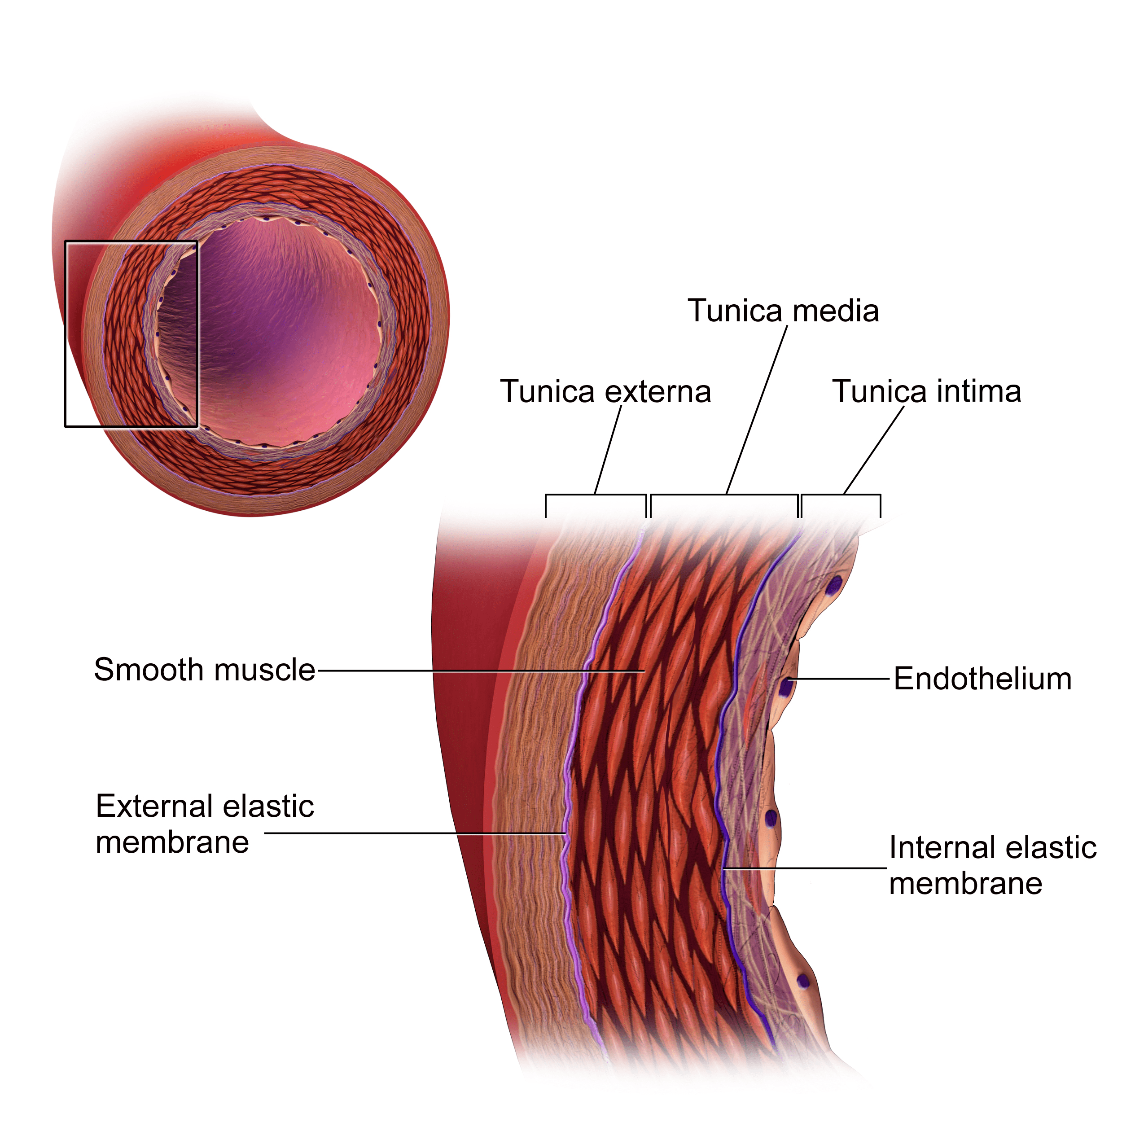
Introduction
Zebrafish: cancer research
Endothelial cells
Permeability

Slide 5
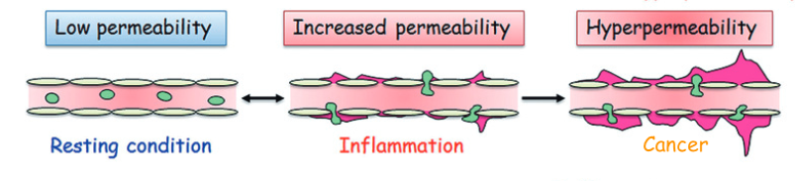
Introduction
Zebrafish: cancer research
Endothelial cells
Permeability

Slide 6

Introduction
Zebrafish: cancer research
Endothelial cells
Permeability
Available experimental data
In nature nanotechnology
Julien Resseguier
Department of Biosciences
Petter Vollestad
PhD Candidate

Slide 7
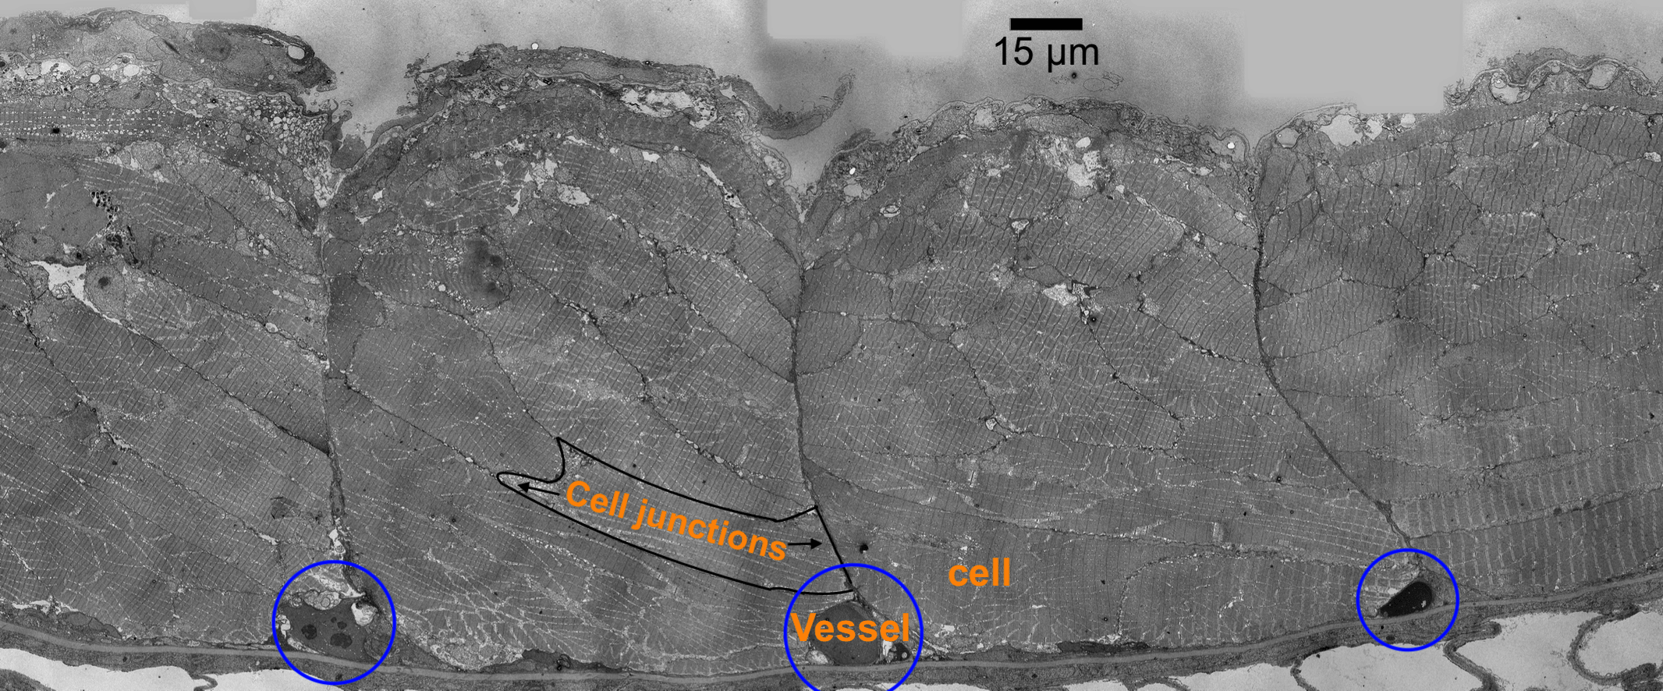
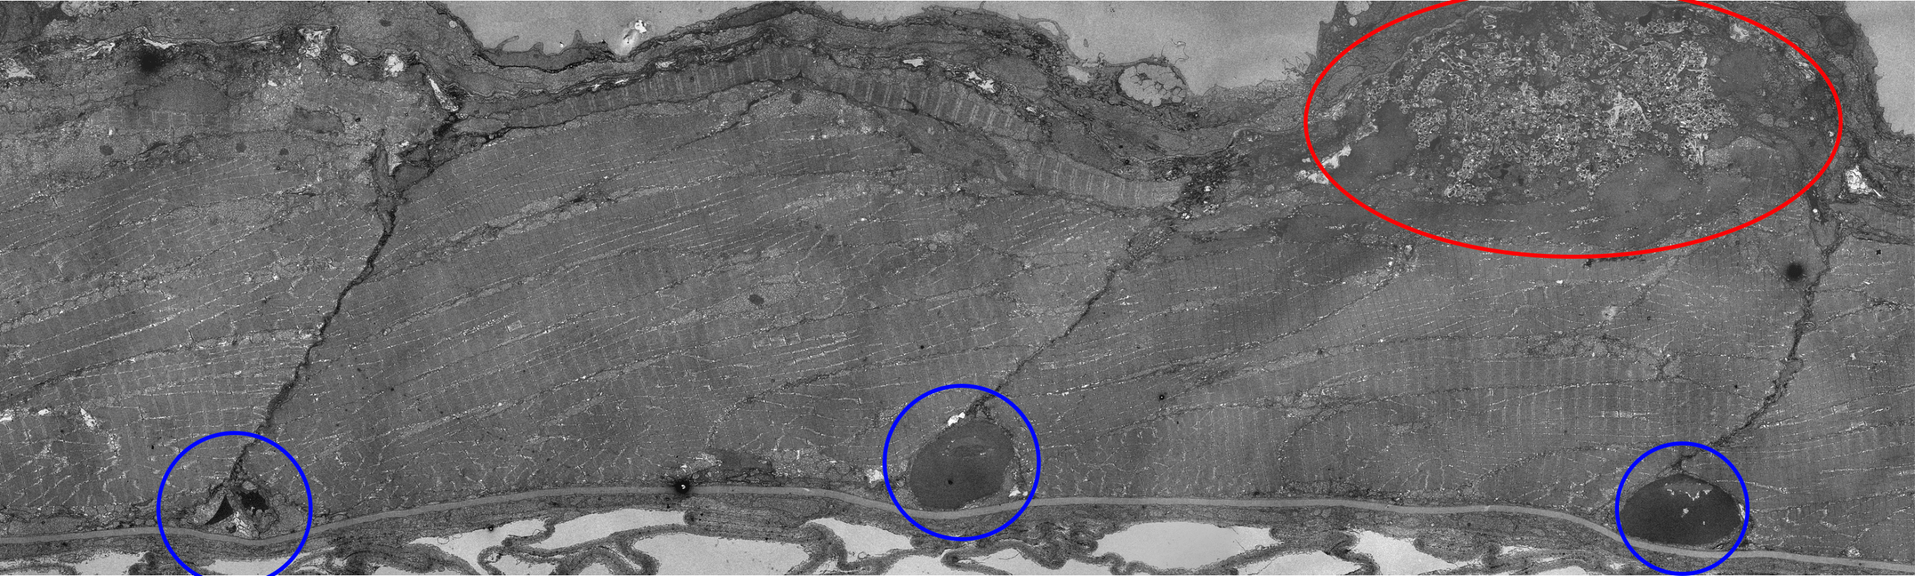
Data from Julien Resseguier

Slide 8
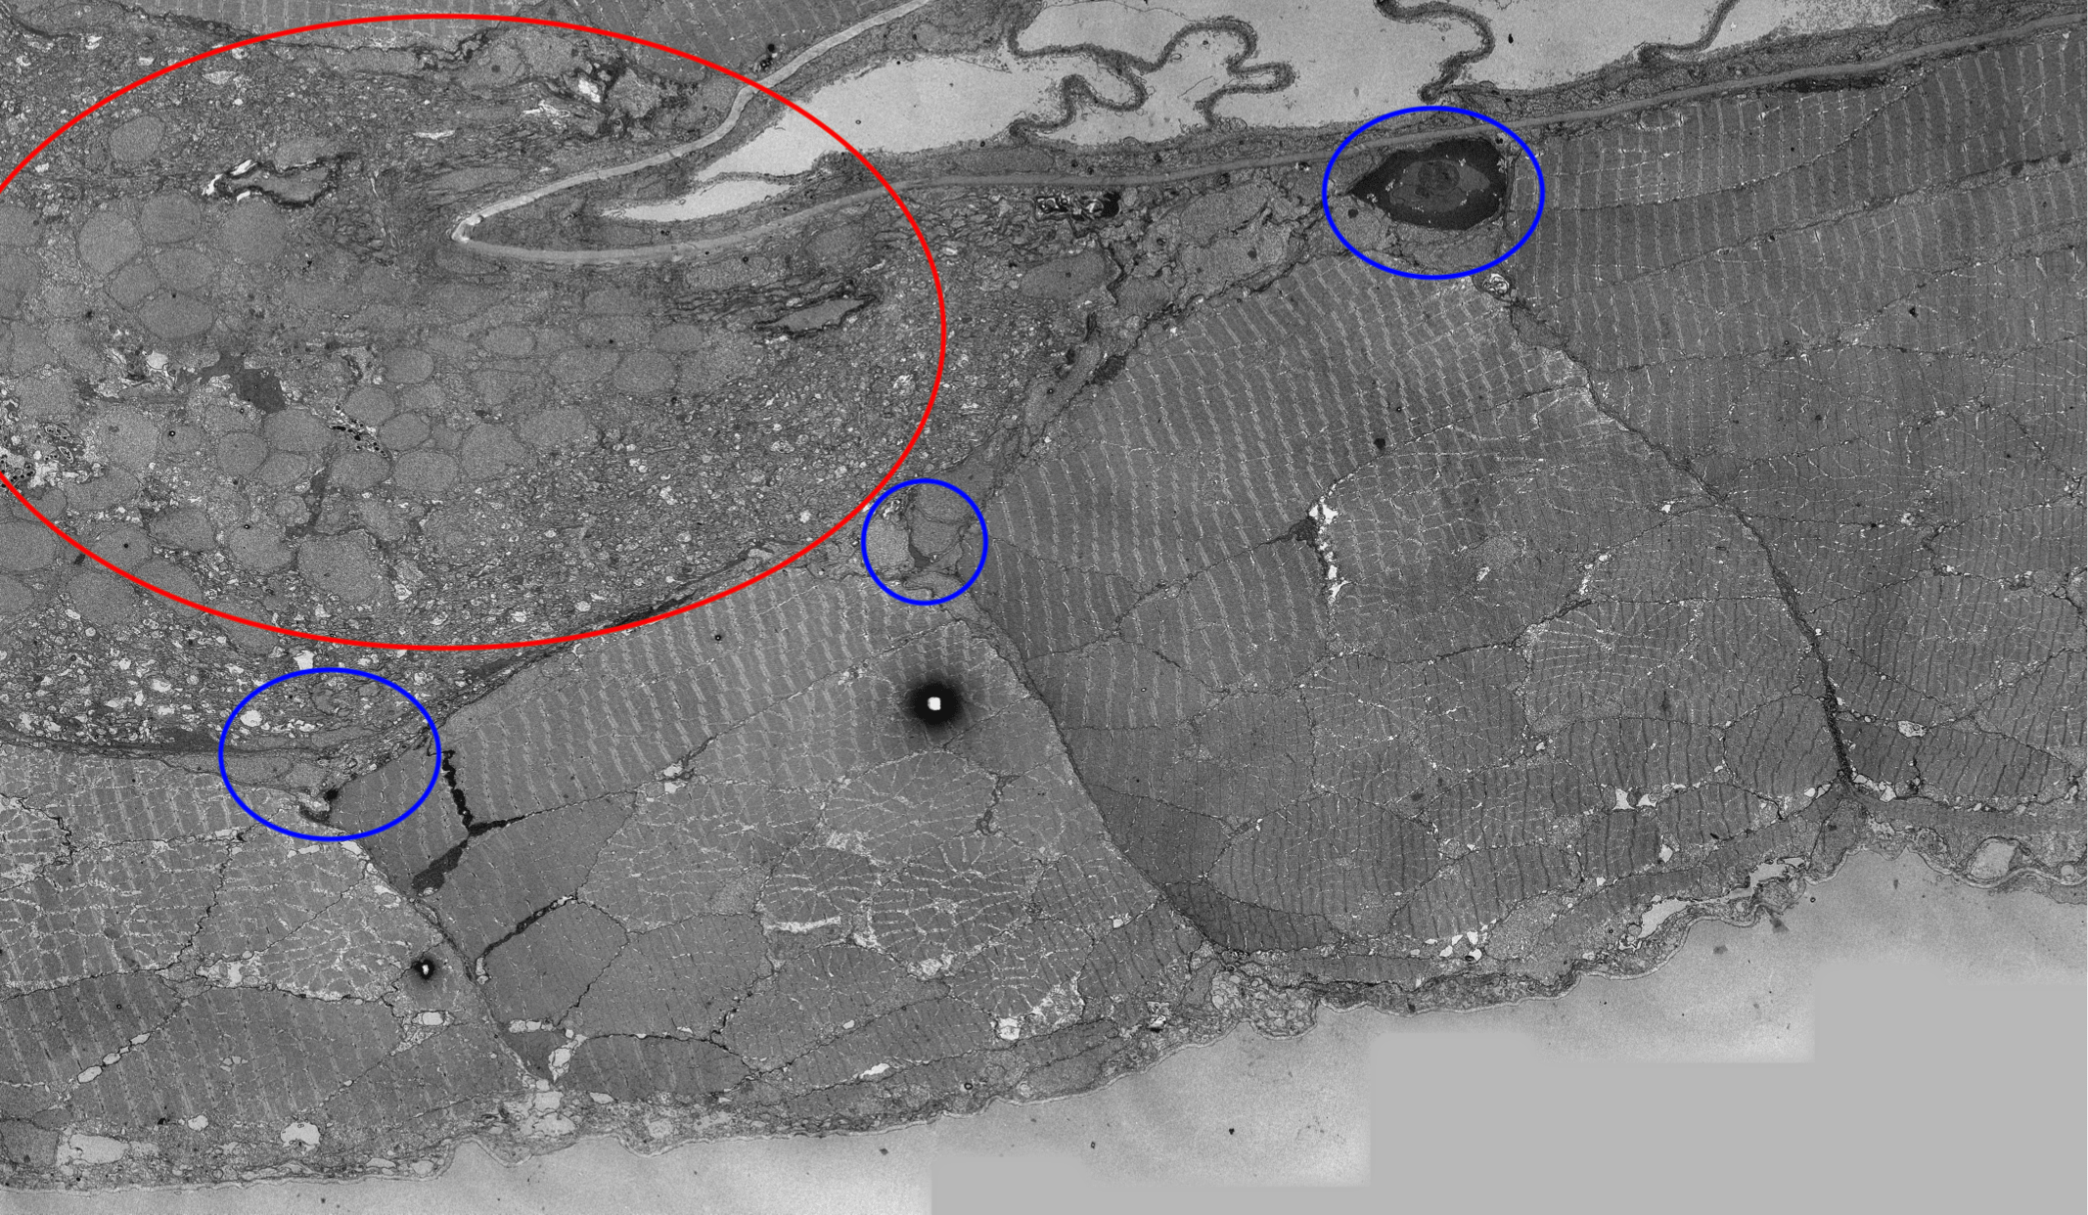
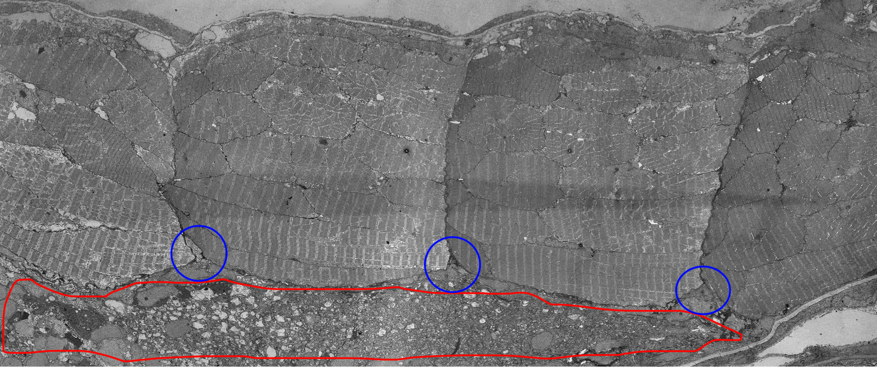
Data from Julien Resseguier

Slide 9
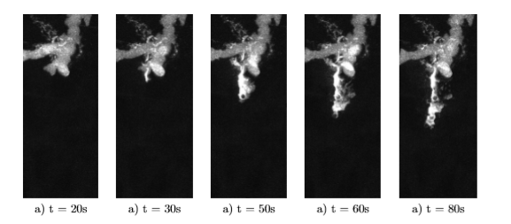
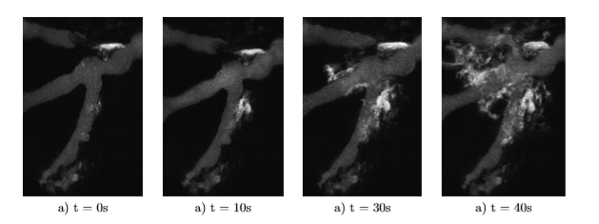
Data from Petter Vollestad
Data from Federico Fenaroli
Visualization and calculations
Laminar outflow
Radial outflow
Comparison with the numerical experiments

Slide 10
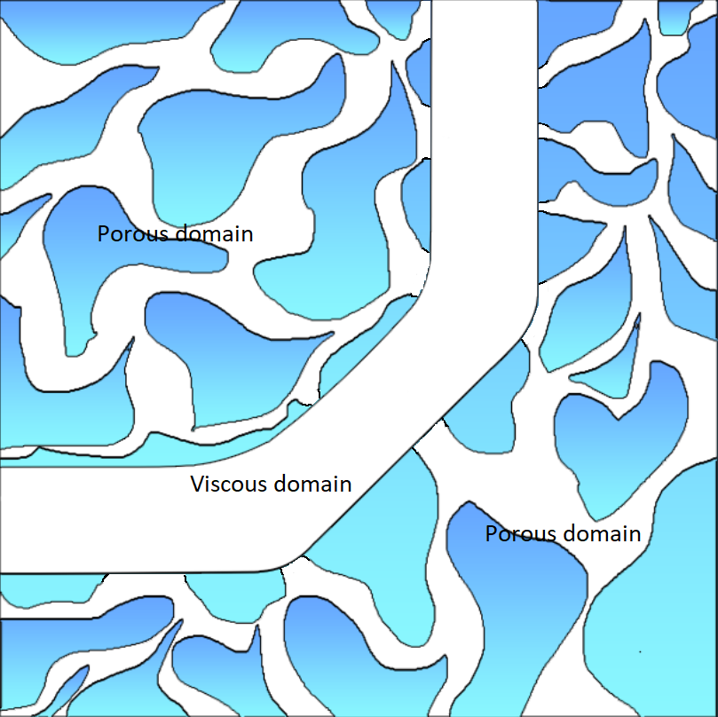
Simplified two-dimensional geometry

Slide 11
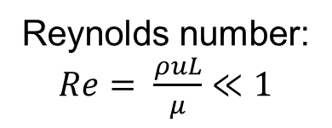
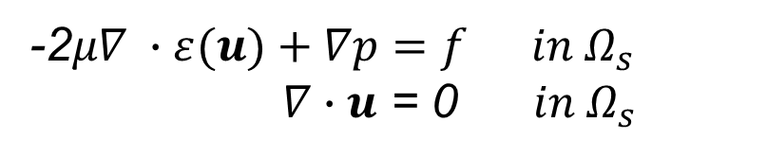
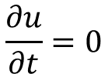
Linear stationary Stokes equation
The equations which models the behavior of incompressible, Newtonian fluids.
Reynolds number:
$Re= \frac{ρuL}{μ}≪1$
$$\frac{∂u}{∂t}=0$$
-2$μ∇ ∙ε(u)+∇p=f in Ω_{s}$
$∇∙u$ = 0 $in Ω_{s}$
Second order operator acting on the velocity and first order operator acting on the pressure.

Slide 12
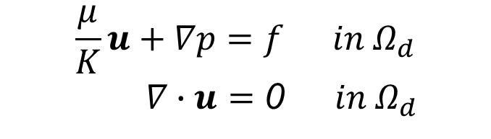
Darcy’s equation
The motion of an incompressible fluid through a saturated porous medium
$$\frac{μ}{K}u+∇p=f in Ω_{d}$$
$∇∙u$ $=$ 0 $in Ω_{d}$
Zero order operator acting on the velocity and first order operator acting on the pressure.

Slide 13
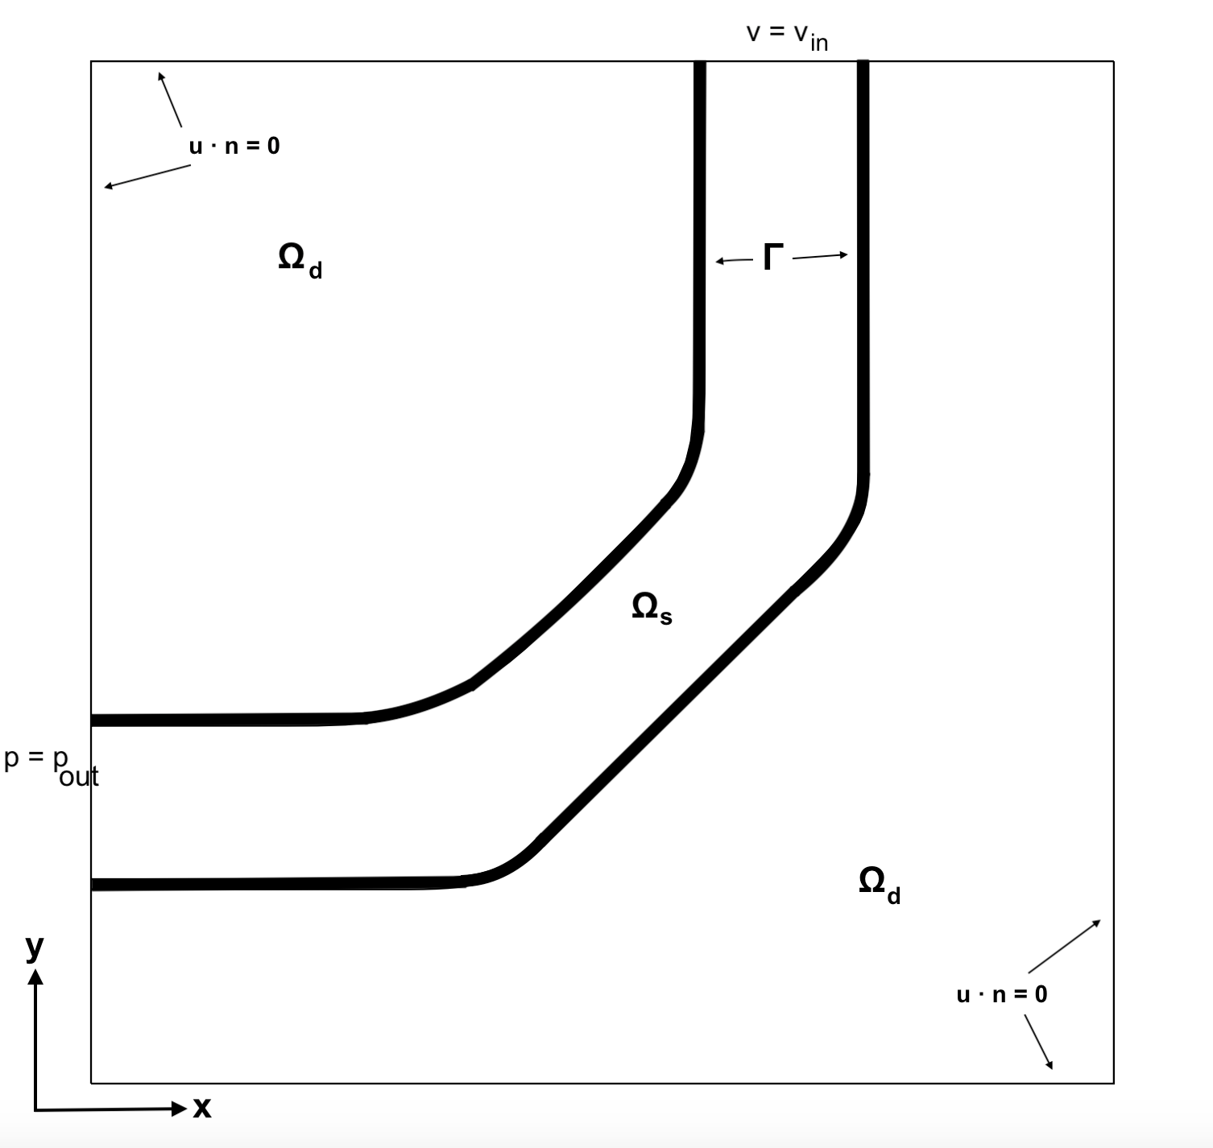
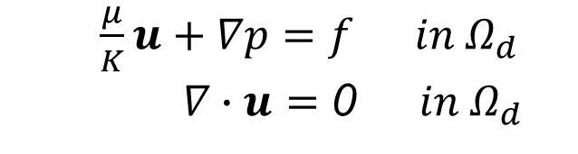
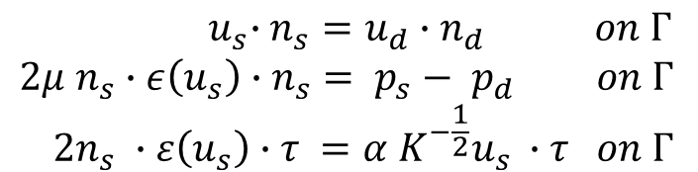
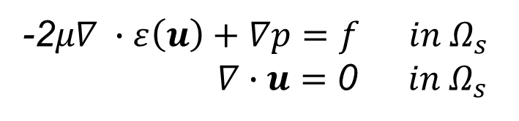
Coupled Darcy-Stokes equation
-2$μ∇ ∙ε\left(u\right)+∇p=f in Ω_{s}$
$∇∙u$ $=$ 0 $in Ω_{s}$
$\frac{μ}{K}u+∇p=f in Ω_{d}$
$∇∙u$ $=$ 0 $in Ω_{d}$
$${ u}_{s}∙n_{s}=u_{d}∙n_{d} on Γ$$
$2μ n_{s}∙ε\left(u_{s}\right)∙n_{s}= p_{s}− p_{d} on Γ$
$$2n_{s} ∙ε\left(u_{s}\right)∙τ =α K^{−\frac{1}{2}}u_{s} ∙τ on Γ$$

Slide 14
Unified Discretization of coupled Darcy–Stokes flow
Challenging to approximate the system with different regularity properties.
Unified discretization of the system are introduced.
L²-formulation from the paper:
Unified Finite Element Discretizations of Coupled Darcy–Stokes Flow
By: Trygve Karper, Kent-Andre Mardal and Ragnar Winther

Slide 15
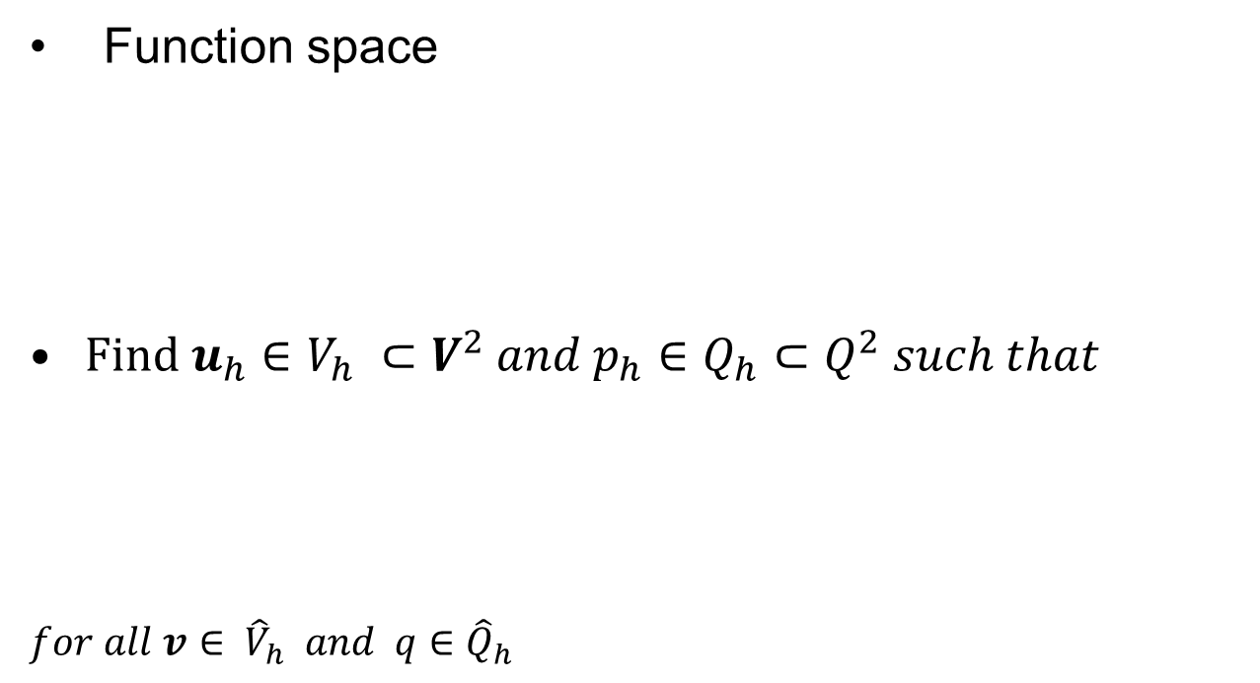

L²-formulation
Function space
$Find u_{h}∈{V_{h} ⊂V}^{2} and p_{h}∈Q_{h}⊂Q^{2} such that$
$for all v∈ {\hat{V}}_{h} and q∈{\hat{Q}}_{h}$
$$V^{2}=V^{2}\left(Ω\right)=\{ v∈L^{2}\left(Ω\right) :v_{s,d}∈H^{1}\left(Ω_{s,d}\right)\}$$
$$Q^{2}=Q^{2}\left(Ω\right)=\{ q∈L_{0}^{2}\left(Ω\right) :q_{s,d}∈H^{1}\left(Ω_{s,d}\right)\}$$
$$a\left(u_{h},v\right)+b\left(p_{h}, v\right)=l\left(v\right)$$
$b\left(q,u_{h}\right)=0$

Slide 16

L²-formulation
$$a\left(u_{h},v\right)+b\left(p_{h}, v\right)=l\left(v\right)$$
$b\left(q,u_{h}\right)=0$
Where:
Porous and Viscous Modeling of Cerebrospinal Fluid Flow in the Spinal Canal Associated with Syringomyelia
By: Ida Norderhaug Drøsdal.
$$a\left(u_{h},v \right)=2μ{\left\langle ε\left(u_{h}\right),ε\left(v\right)\right\rangle }_{Ω_{s}}+ \frac{μ}{K}{\left\langle u_{h},v \right\rangle }_{Ω_{s}}−μ{\left\langle αK^{\frac{1}{2}}u ∙τ,v∙τ\right\rangle }_{Γ}− {\left\langle p_{s}−p_{d},v∙n_{s}\right\rangle }_{Γ}$$
$$b\left(p_{h},v\right)={\left\langle ∇p_{h},v\right\rangle }_{Ω_{d}}−{\left\langle p_{h},∇∙v\right\rangle }_{Ω_{s}}+{\left\langle p_{h},v∙n_{s}\right\rangle }_{Γ}$$
$$b\left(q,u_{h}\right)={\left\langle ∇∙u_{h},q\right\rangle }_{Ω_{s,d}}$$
$$l(v) ={\left\langle f,v\right\rangle }_{Ω_{s,d}}$$

Slide 17
L²-formulation
$$a\left(u_{h},v\right)+b\left(p_{h}, v\right)=l\left(v\right)$$
$b\left(q,u_{h}\right)=0$
Where:
$$a\left(u_{h},v \right)=2μ{\left\langle ε\left(u_{h}\right),ε\left(v\right)\right\rangle }_{Ω_{s}}+ \frac{μ}{K}{\left\langle u_{h},v \right\rangle }_{Ω_{s}}$$
$$b\left(p_{h},v\right)={\left\langle ∇p_{h},v\right\rangle }_{Ω_{d}}−{\left\langle p_{h},∇∙v\right\rangle }_{Ω_{s}}+{\left\langle p_{h},v∙n_{s}\right\rangle }_{Γ}$$
$$b\left(q,u_{h}\right)={\left\langle ∇∙u_{h},q\right\rangle }_{Ω_{s,d}}$$
$$l(v) ={\left\langle f,v\right\rangle }_{Ω_{s,d}}$$

Slide 18
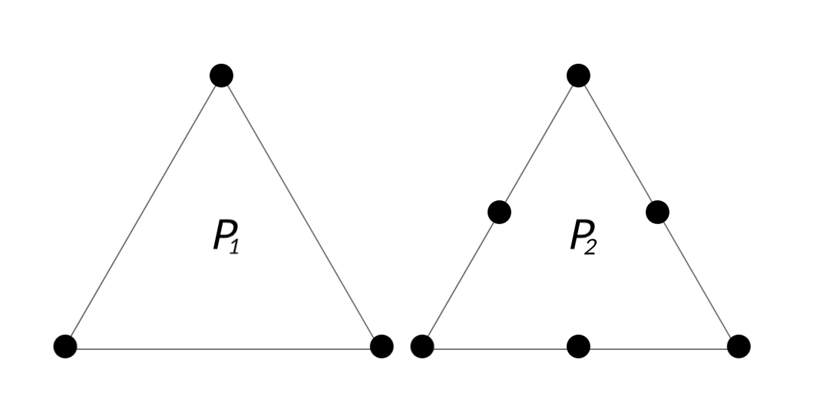
Finite Elements
Finite elements determine the shape of polynomial approximation over each cell, and how these are connected at the cell boundaries.
Taylor-Hood elements.
basis functions are generated by continuous, piecewise polynomial approximations.

Slide 19
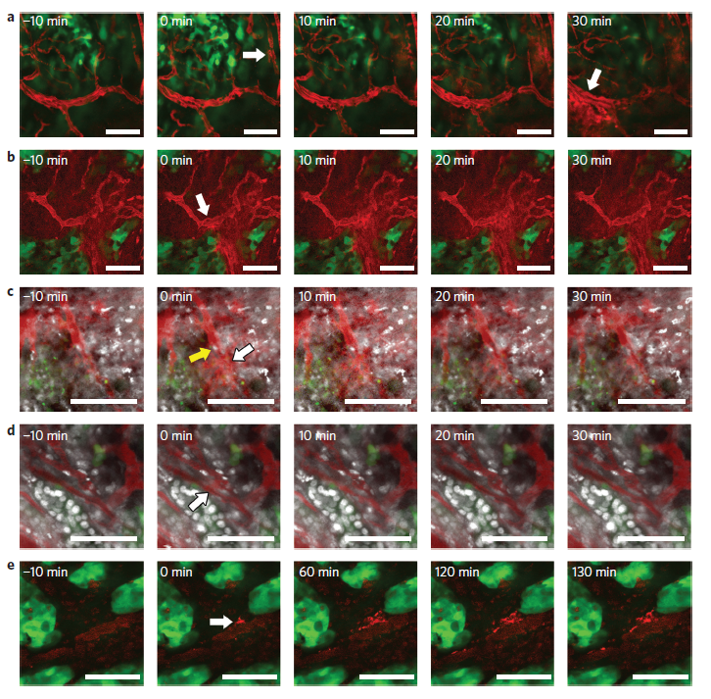
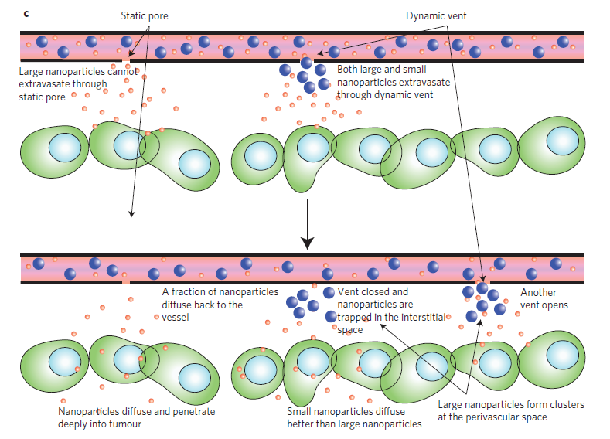
The goal is to simulate an eruption by increasing the permeability

Slide 20
Numerical experiments
FEniCS
Scaling
Permeability ( resting condition ) | $$1.36∙10^{−9} μm^{2}$$
Viscosity | $$0.00496 Pa∙s$$
Length ( viscous domain ) | $$130 μm$$
Diameter ( viscous domain ) | $$15 μm$$
Gap size ( interface domain ) | $$2.8 μm to 4 μm$$
Diameter of the wall | $$0.6 μm$$

Slide 21
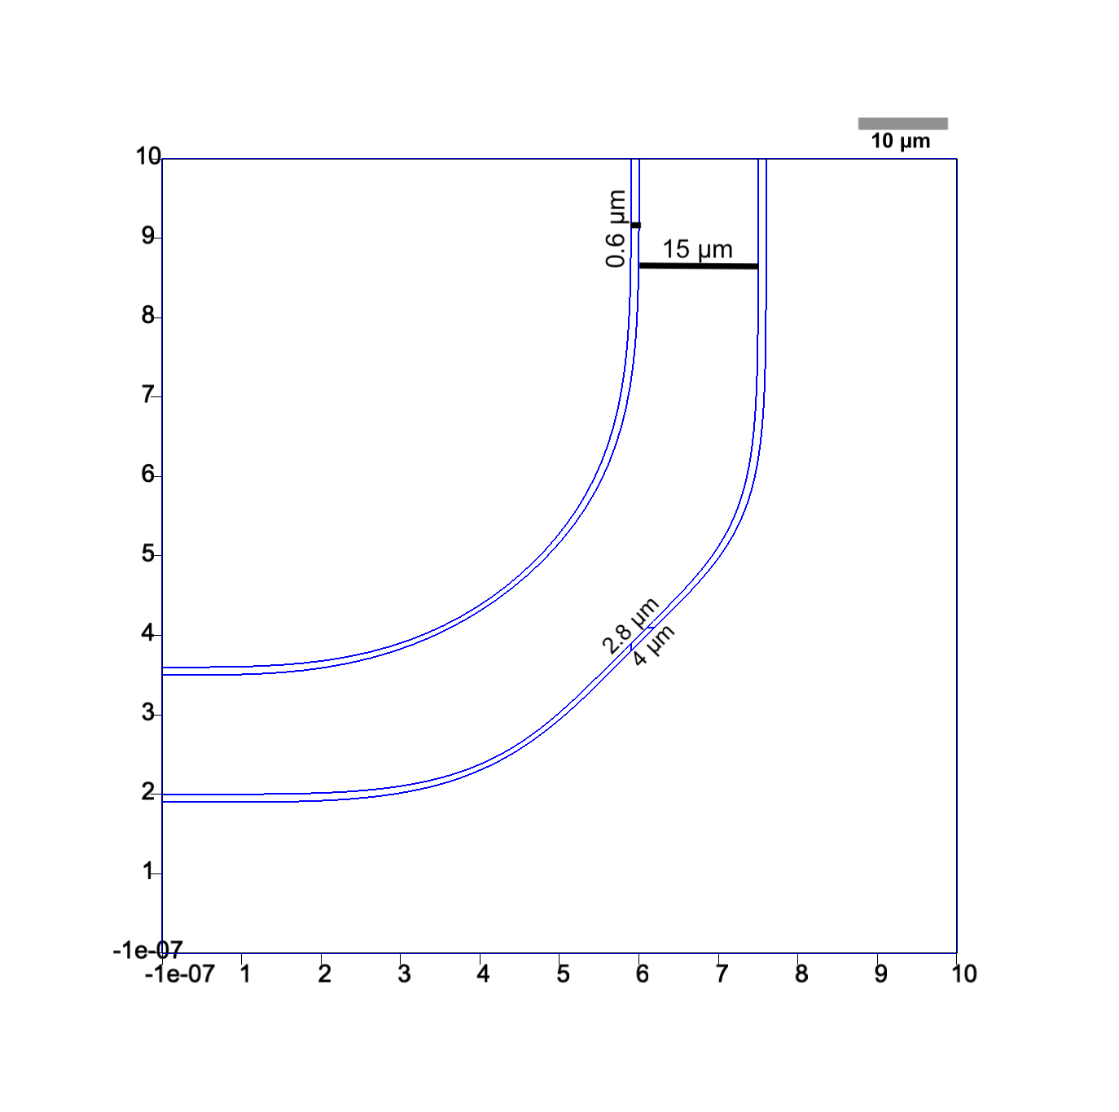
Numerical experiments
FEniCS
Scaling
Mesh
Point values
increased amount of elements around the boundaries
Frontal-Delaunay algorithm

Slide 22
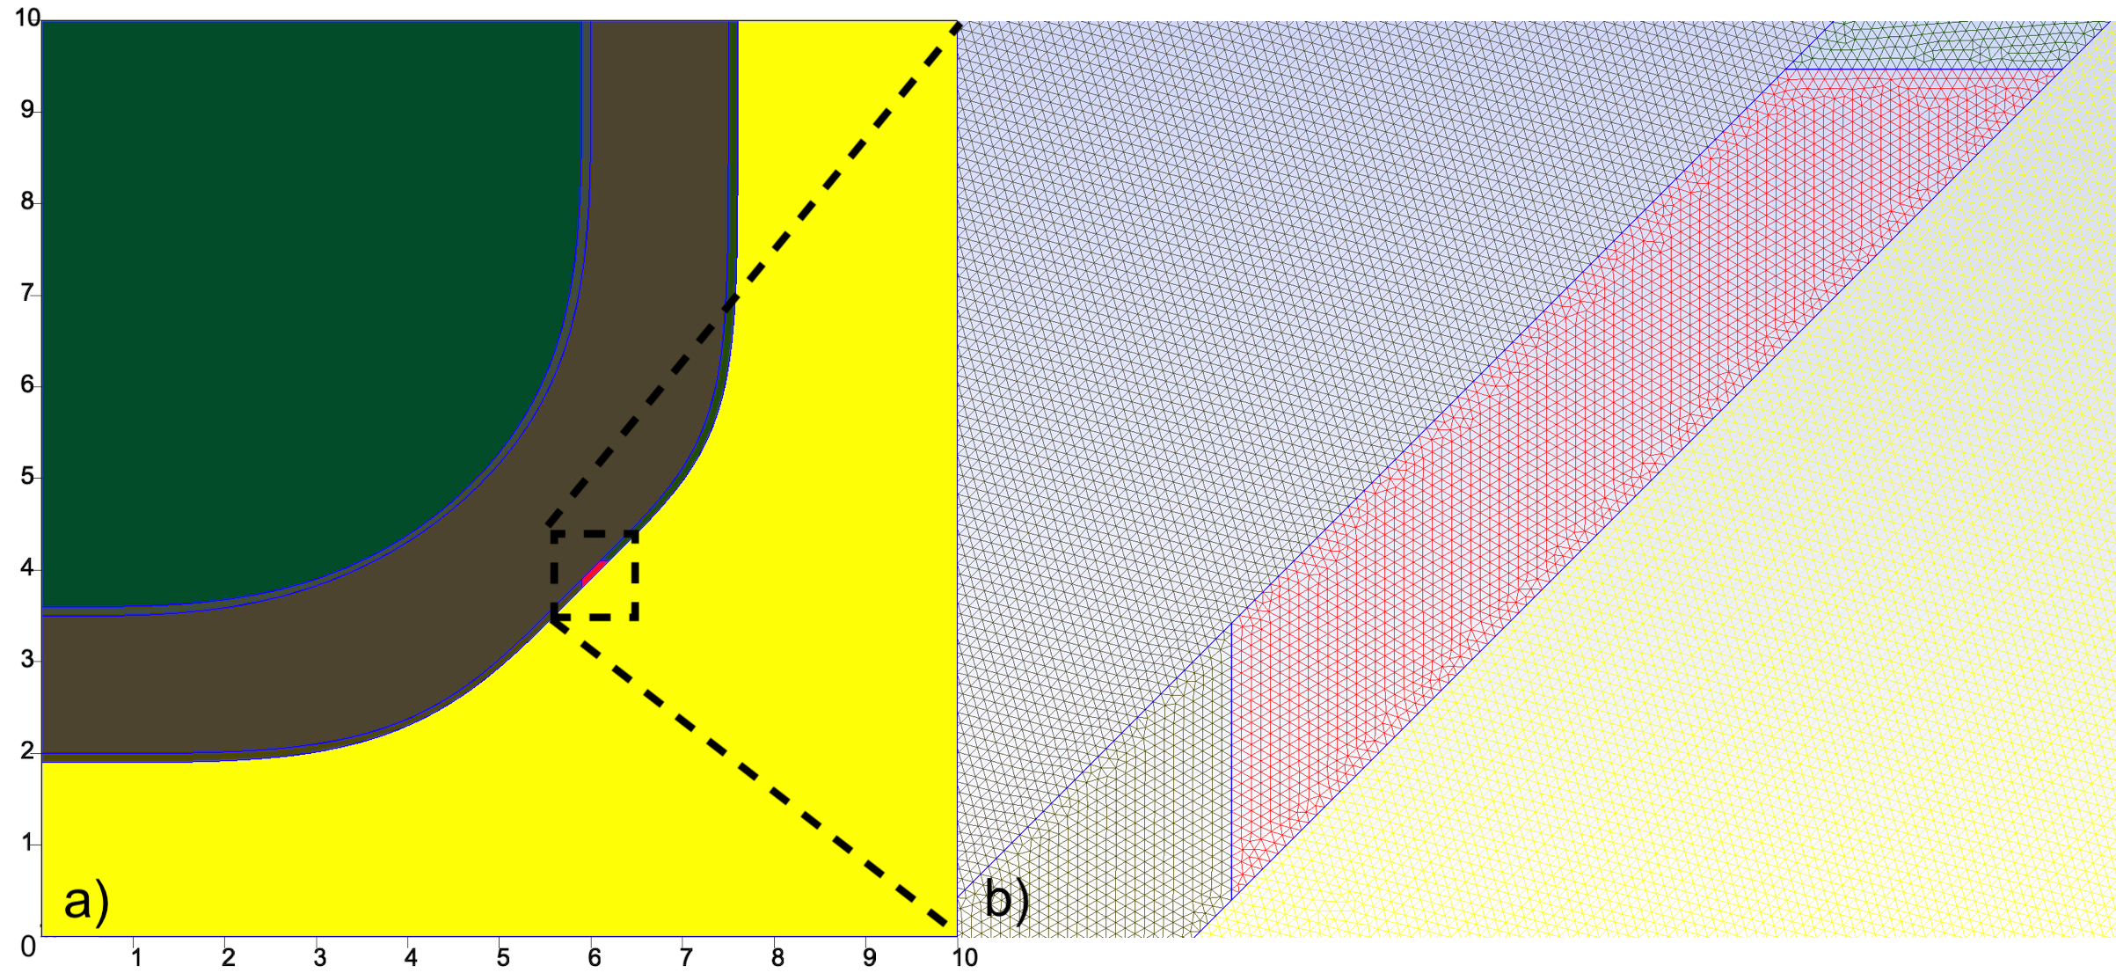
Numerical experiments
FEniCS
Scaling
Mesh

Slide 23
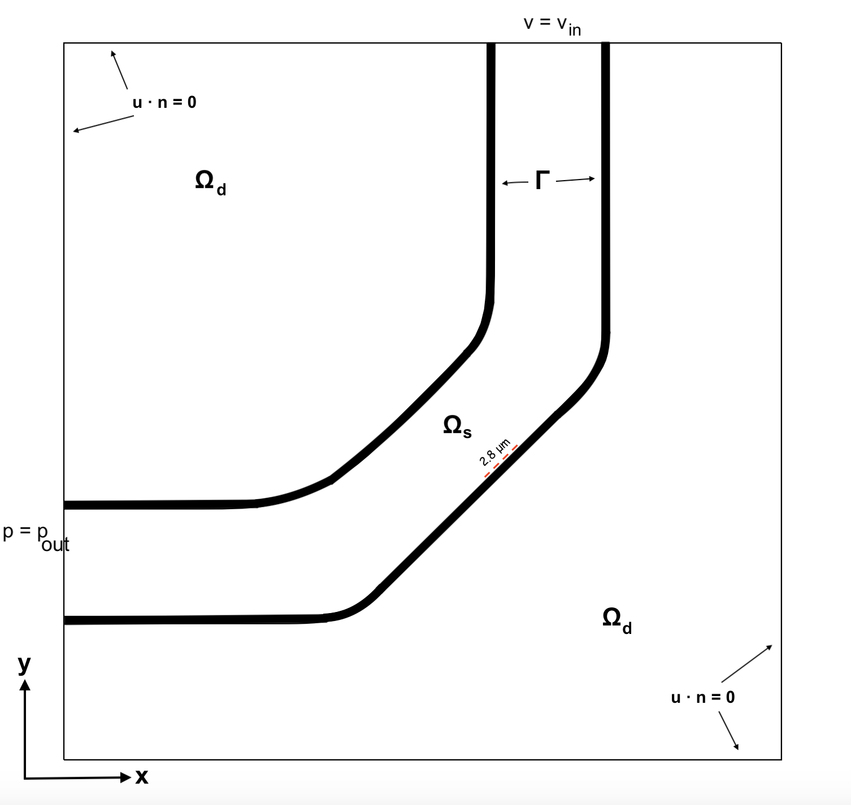
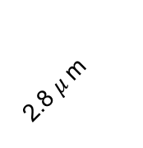
Eruption in an enclosed space
Boundary conditions
Inflow and outflow conditions
Permeability
Low permeability
Increased permeability
Hyperpermeability
2.8 $μ$m

Slide 24
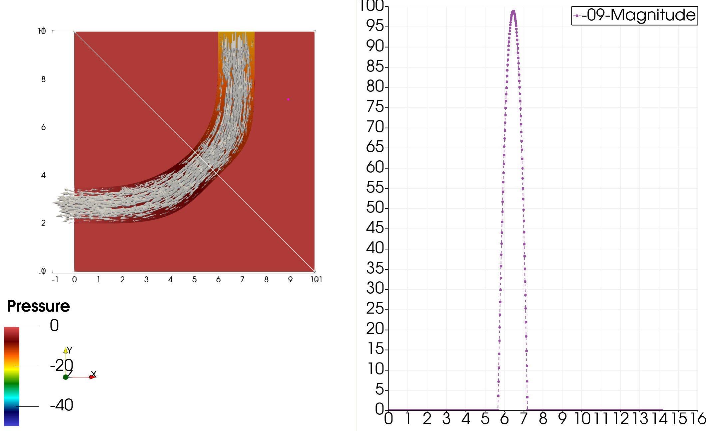
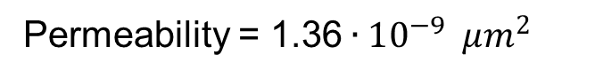
Low permeability
Permeability = 1.36$∙10^{−9 }$ $μm^{2}$

Slide 25
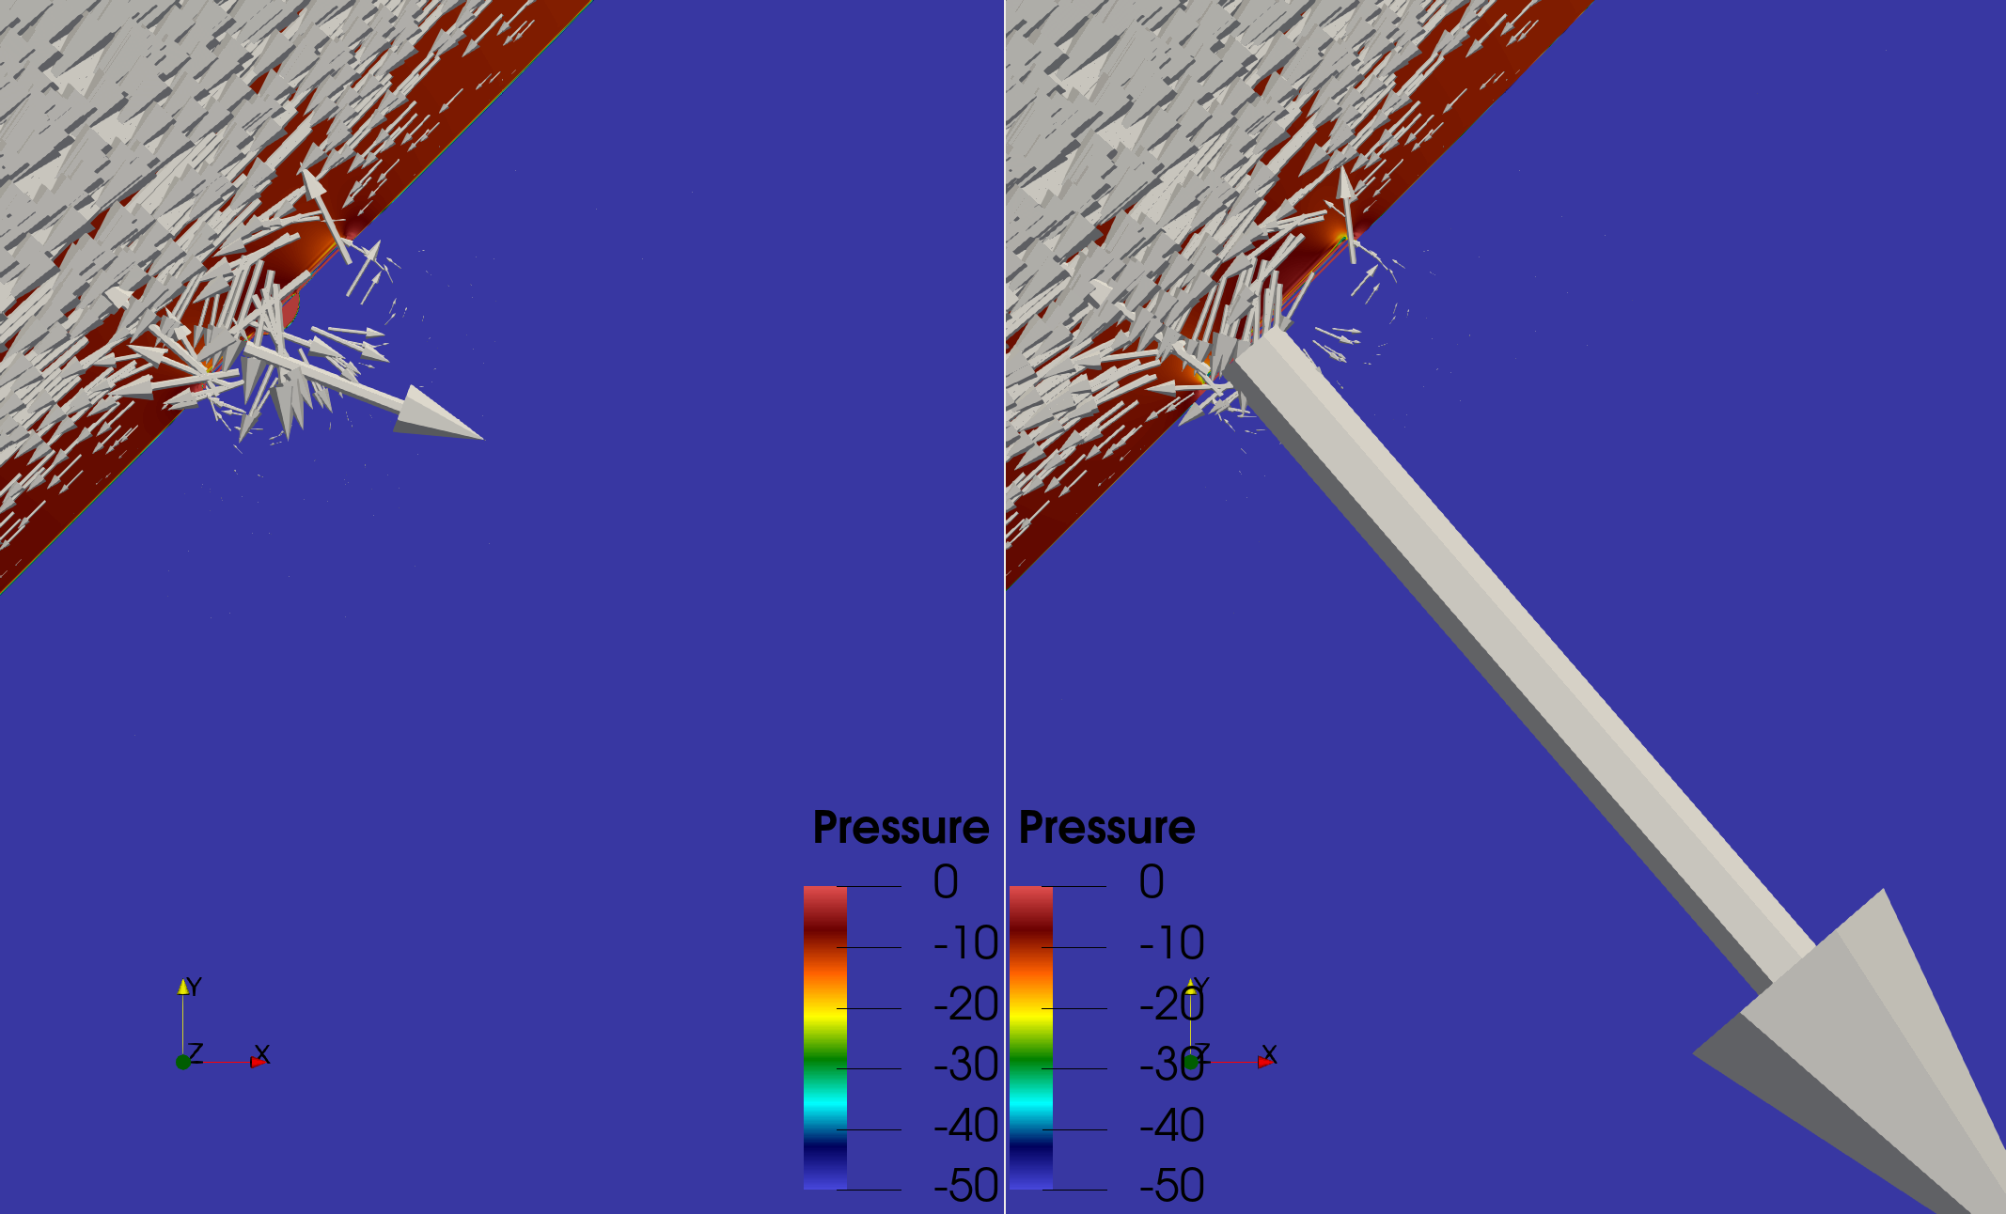
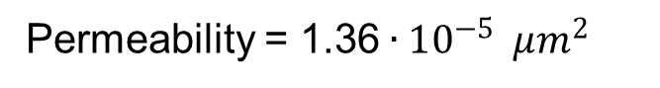
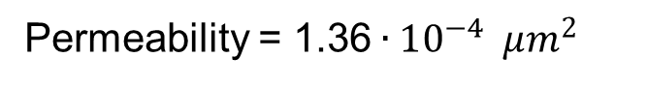
Increased permeability
Permeability = 1.36$∙10^{−5 }$ $μm^{2}$
Permeability = 1.36$∙10^{−4 }$ $μm^{2}$

Slide 26
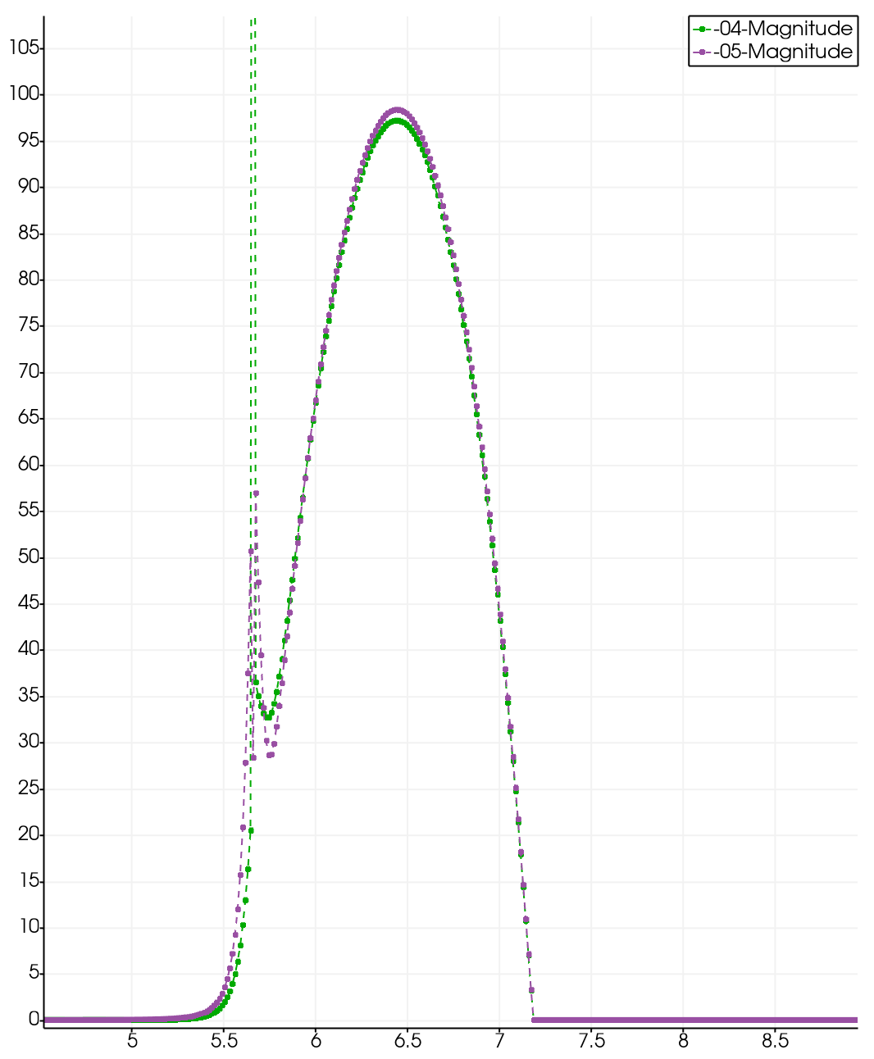
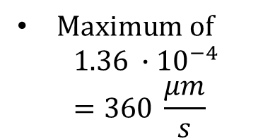
$Maximum of$
$$1.36 ∙{10}^{−4}=360 \frac{μm}{s}$$

Slide 27
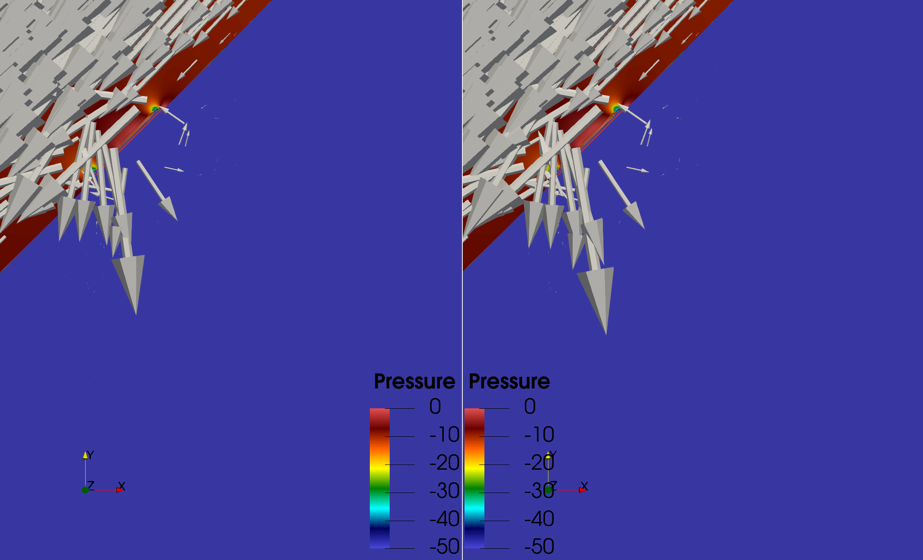
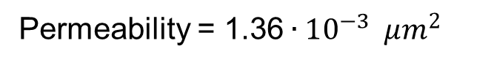
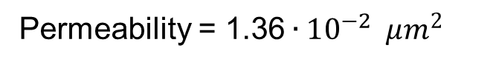
Hyperpermeability
Permeability = 1.36$∙10^{−3 }$ $μm^{2}$
Permeability = 1.36$∙10^{−2 }$ $μm^{2}$

Slide 28
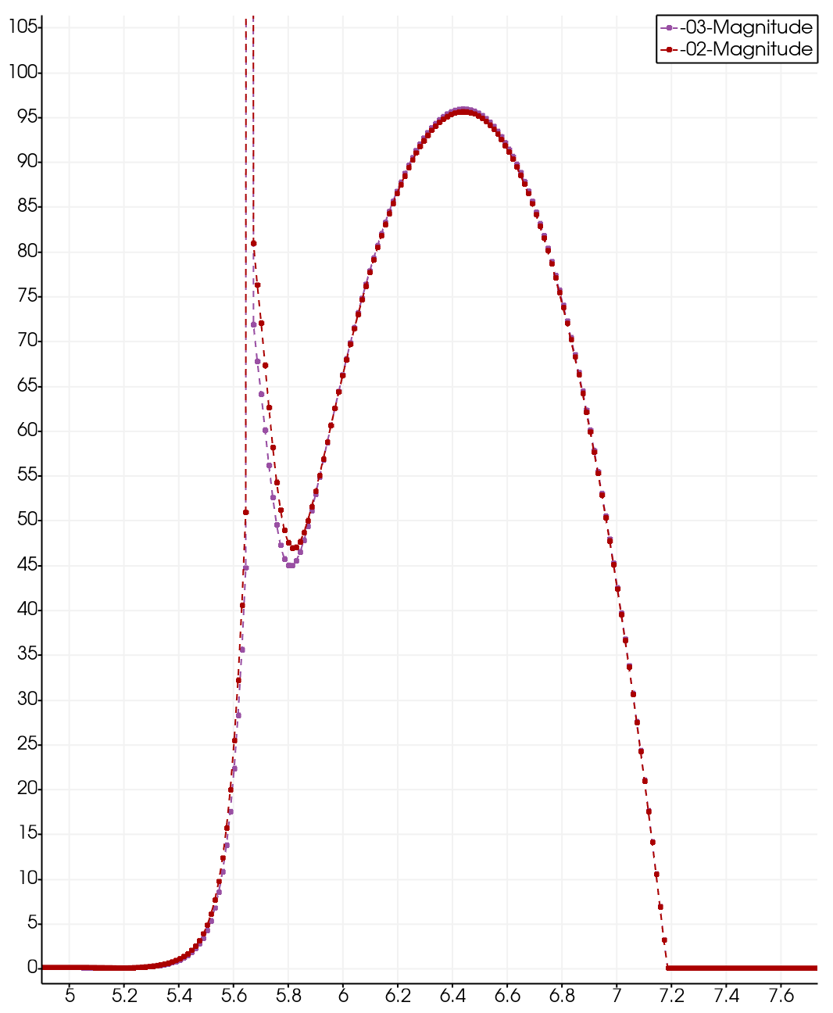
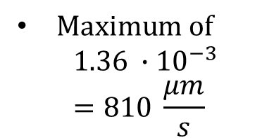
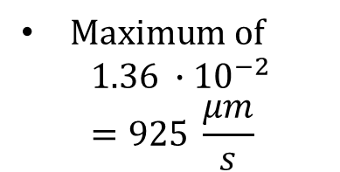
$Maximum of$
$$1.36 ∙{10}^{−3}=810 \frac{μm}{s}$$
$Maximum of$
$$1.36 ∙{10}^{−2}=925 \frac{μm}{s}$$

Slide 29
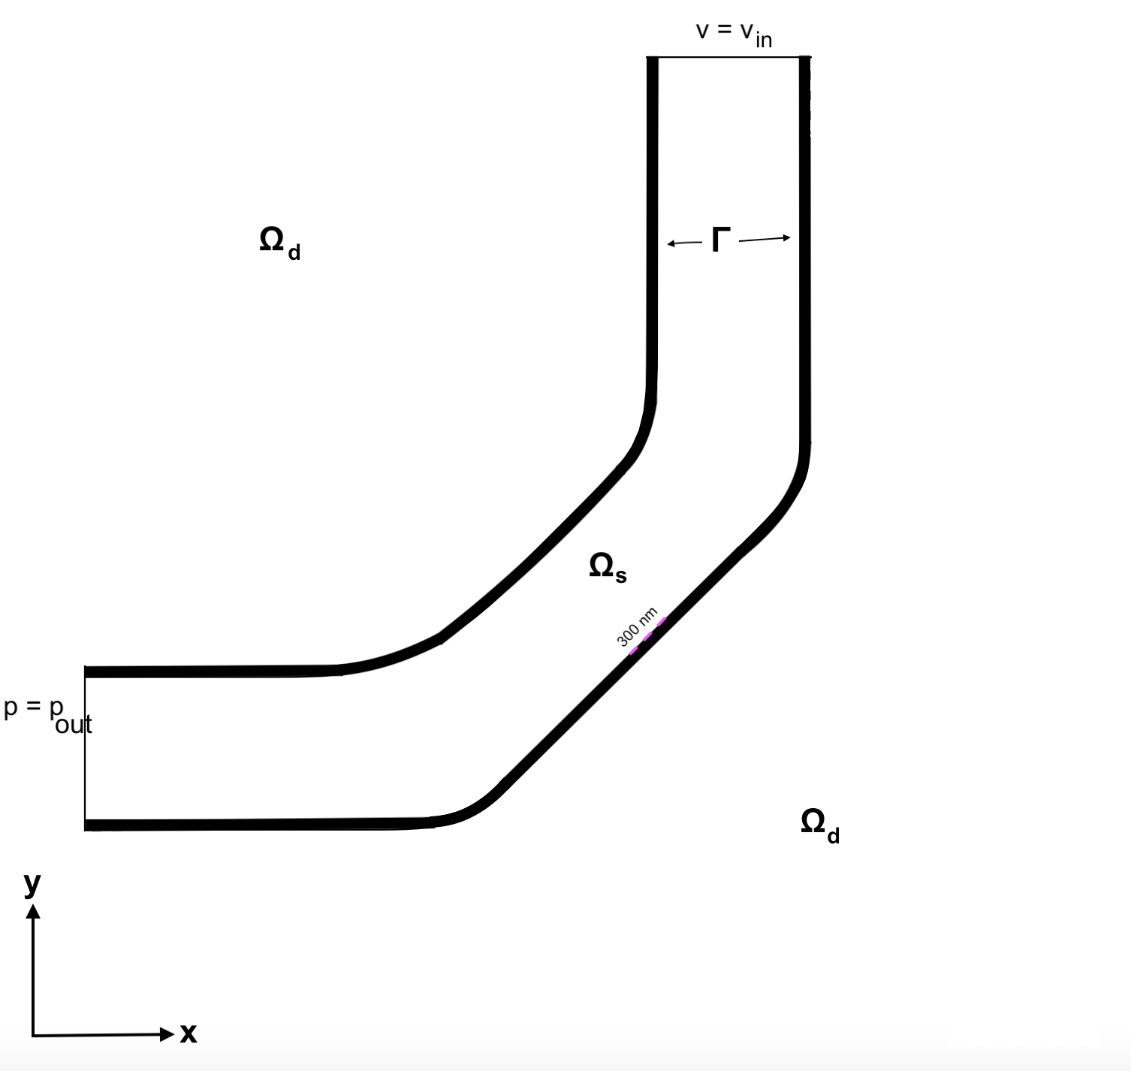
Eruption in an open space
Boundary conditions
Inflow and outflow conditions
Permeability
Low permeability
Increased permeability
Hyperpermeability
300 nm

Slide 30
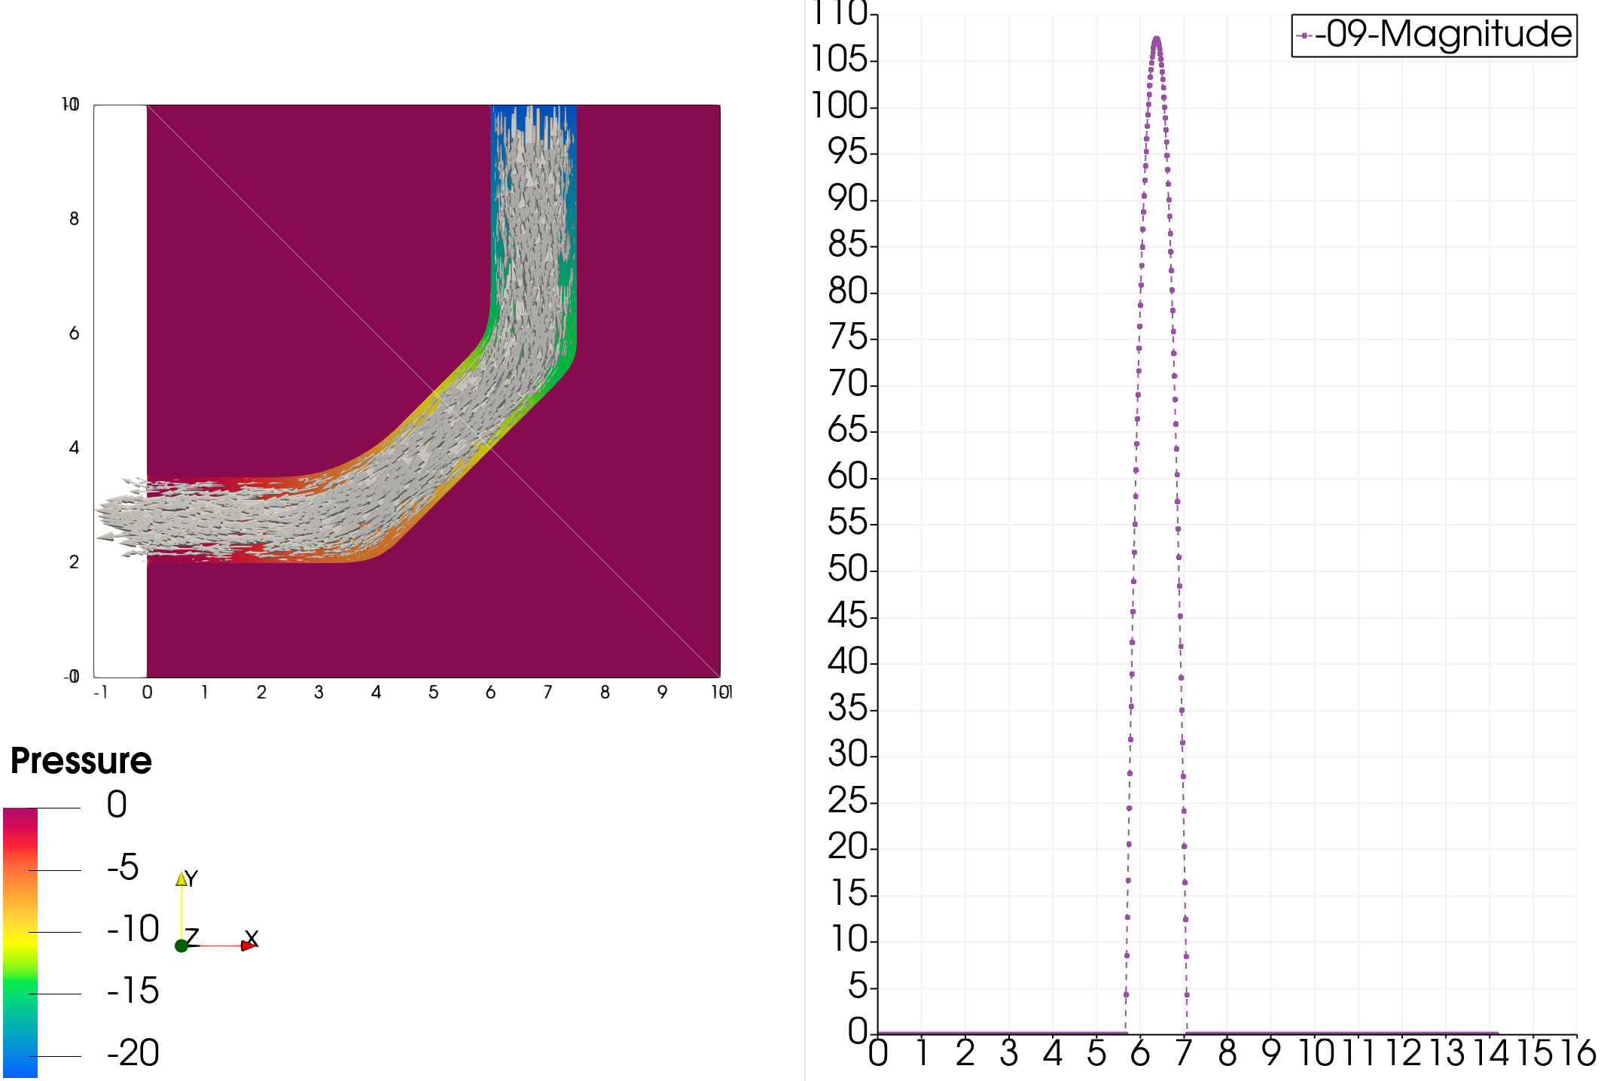
Low permeability
Permeability = 1.36$∙10^{−9 }$ $μm^{2}$

Slide 31
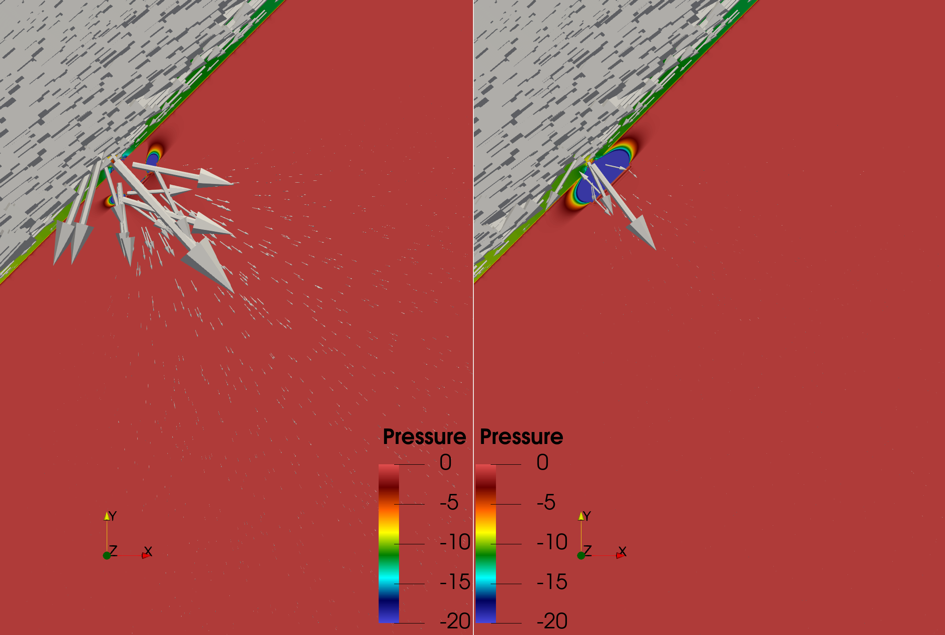
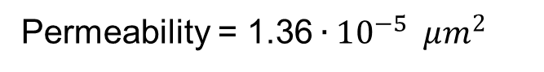
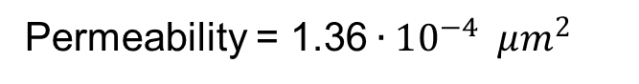
Increased permeability
Permeability = 1.36$∙10^{−5 }$ $μm^{2}$
Permeability = 1.36$∙10^{−4 }$ $μm^{2}$

Slide 32
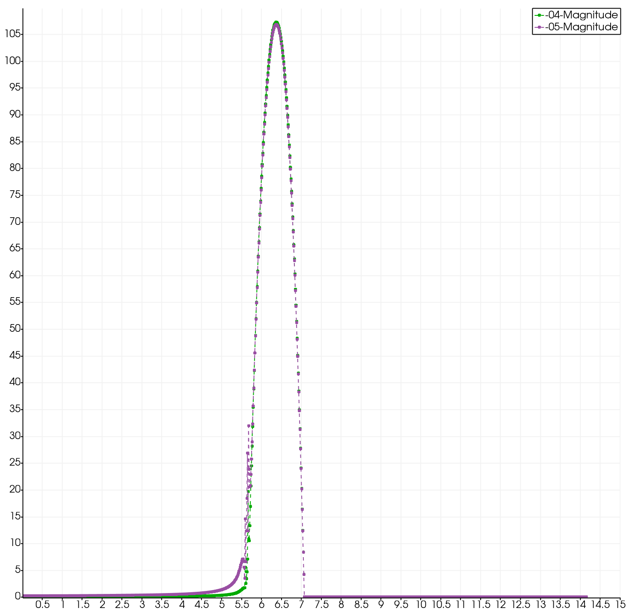

Slide 33
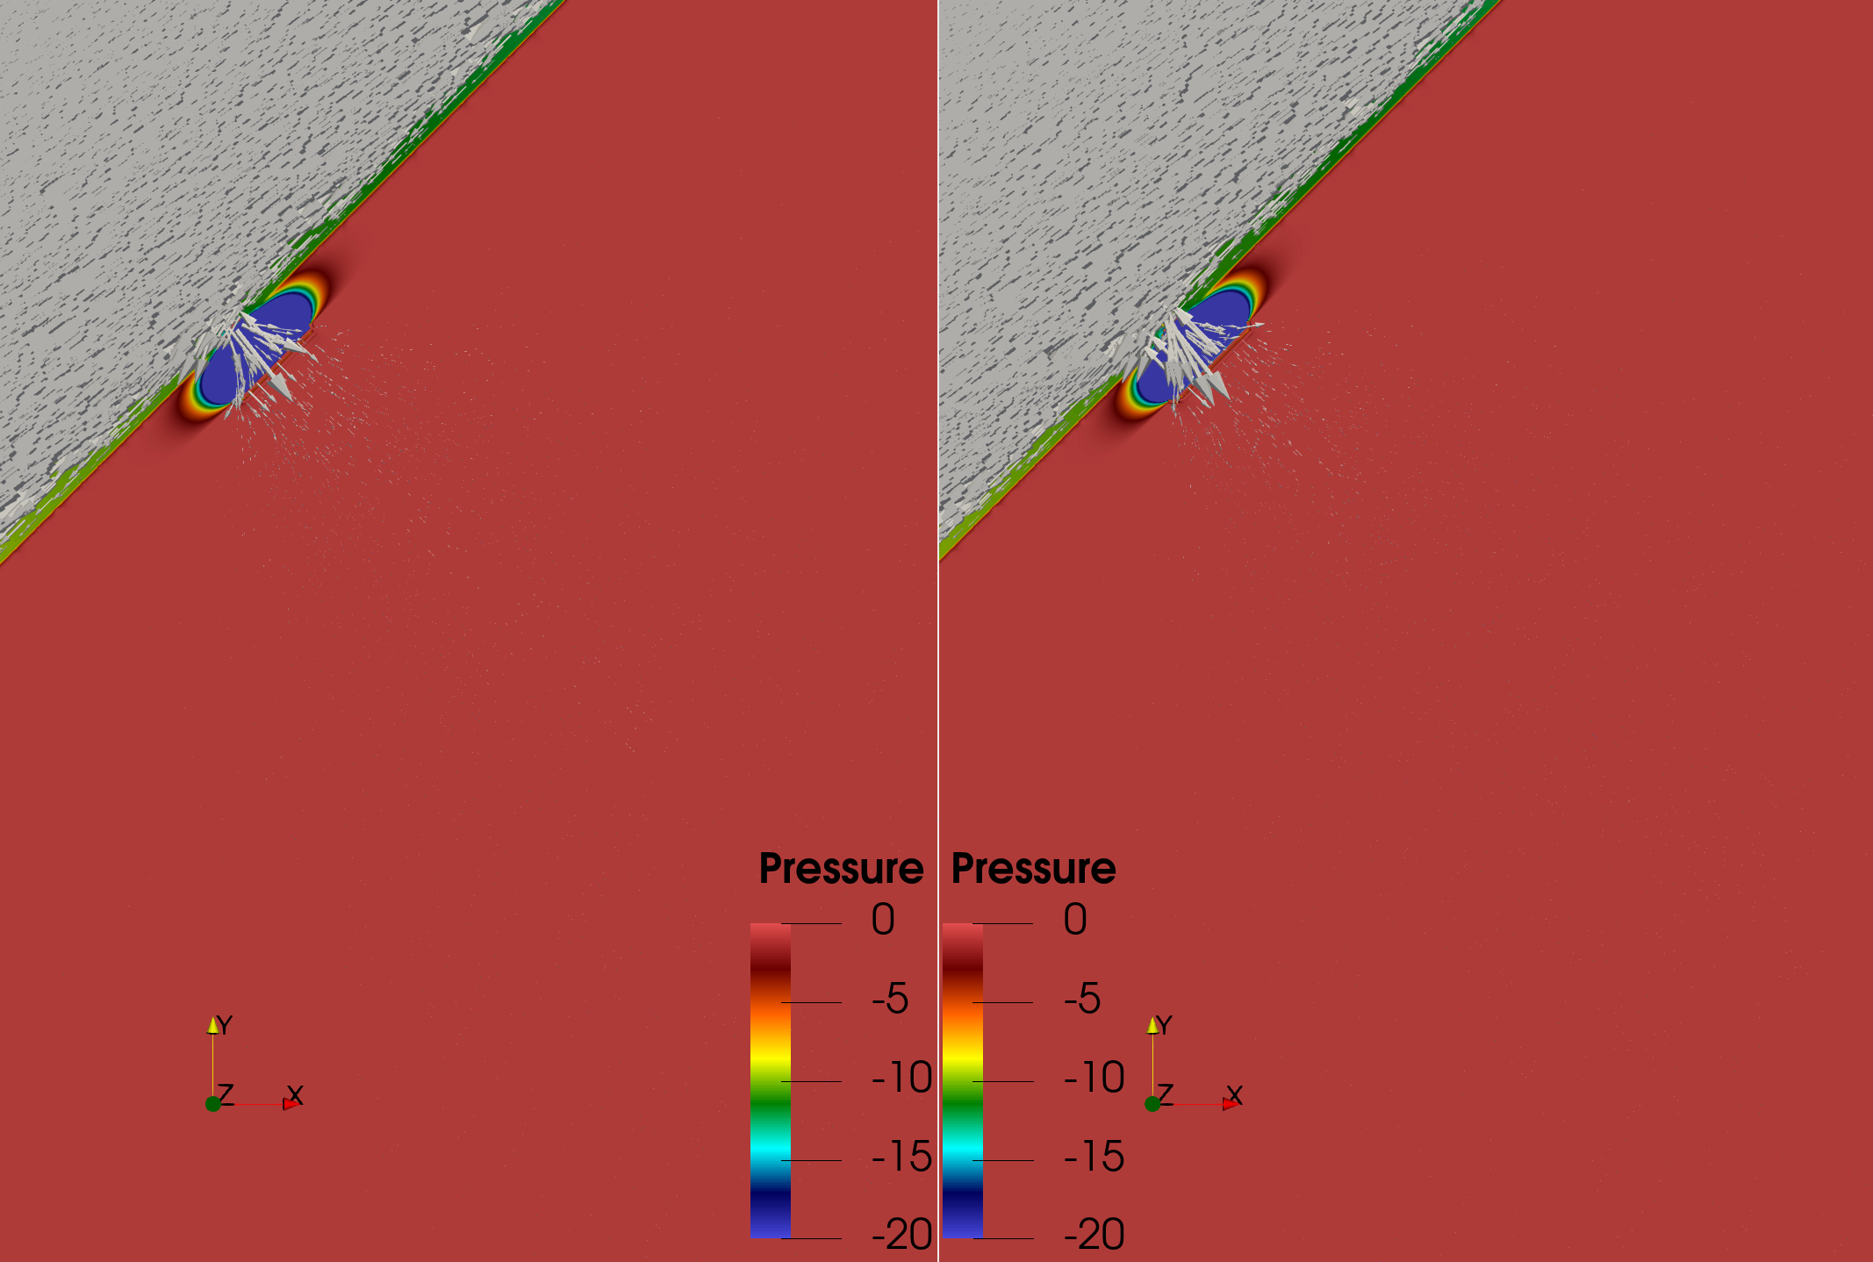
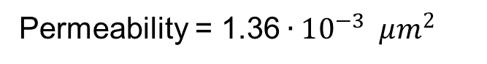
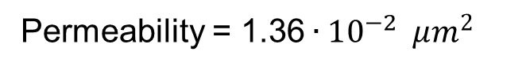
Hyperpermeability
Permeability = 1.36$∙10^{−3 }$ $μm^{2}$
Permeability = 1.36$∙10^{−2 }$ $μm^{2}$

Slide 34
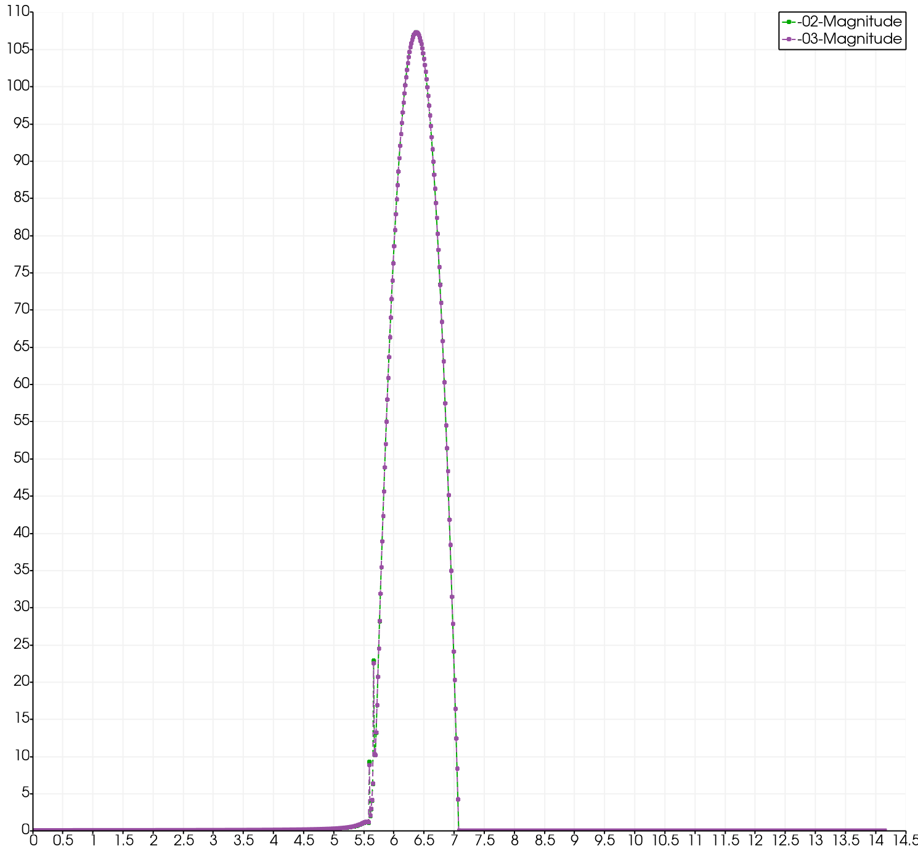

Slide 35


Velocity and Pressure Development
Pressure change
From available data: 0.03340 Pa
Poiseuille’s equation:
From the numerical experiments: 0.0140 Pa
$∇p= \frac{8μuL}{r^{2}}$

Slide 36

Velocity and Pressure Development
Pressure change
Velocity development
From available data: 300 $\frac{μm}{s}$
From the numerical experiments: 313 $\frac{μm}{s}$

Slide 37
Velocity and Pressure Development
Pressure change
Velocity development

Slide 38

Velocity and Pressure Development
Pressure change
Velocity development
Permeability | Time
$$1.36∙{10}^{−9}μm^{2}$$ | 0$s$
$$1.36∙{10}^{−6}μm^{2}$$ | 40 $s$
$$1.36∙{10}^{−5}μm^{2}$$ | 50 $s$
$$1.36∙{10}^{−4}μm^{2}$$ | 60 $s$
$$1.36∙{10}^{−3}μm^{2}$$ | 80 $s$
$$1.36∙{10}^{−2}μm^{2}$$ | 100 $s$
$$1.36∙{10}^{−1}μm^{2}$$ | 120 $s$

Slide 39
Conclusions
Stationary L²-formulation of coupled Darcy-Stokes discretized with Taylor-Hood elements was implemented on a two-dimensional mesh.
The impact of permeability on eruption development.
A robust model for fluid behave have been generated.
Relative good comparison with available experimental data.

Slide 40

Further Work
Better view of an eruption development can be accomplished by increasing the permeability with a smaller factor.
Converting the Stokes equation from stationary to non-stationary
$\frac{∂u}{∂t}≠0$
Introducing a more realistic three-dimensional geometry for the numerical method.

Slide 41
Thank you for your attention

